Slide 1
Borders
Taught by Yossef Ayman Zedan

Slide 2

Additives
<span class="border"></span> <span class="border-top"></span> <span class="border-end"></span> <span class="border-bottom"></span> <span class="border-start"></span>

Slide 3

Subtractive
<span class="border-0"></span> <span class="border-top-0"></span> <span class="border-end-0"></span> <span class="border-bottom-0"></span> <span class="border-start-0"></span>

Slide 4
Border color
Add border-color next to border or border-direction
<span class="border border-primary"></span> <span class="border border-secondary"></span> <span class="border border-success"></span> <span class="border border-danger"></span> <span class="border border-warning"></span> <span class="border border-info"></span> <span class="border border-light"></span> <span class="border border-dark"></span> <span class="border border-white"></span>

Slide 5
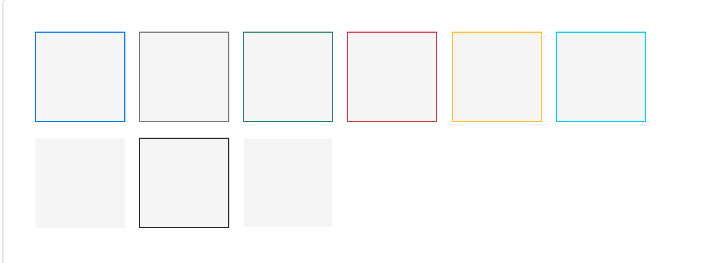
Border color

Slide 6

Border width
<span class="border border-1"></span> <span class="border border-2"></span> <span class="border border-3"></span> <span class="border border-4"></span> <span class="border border-5"></span>

Slide 7
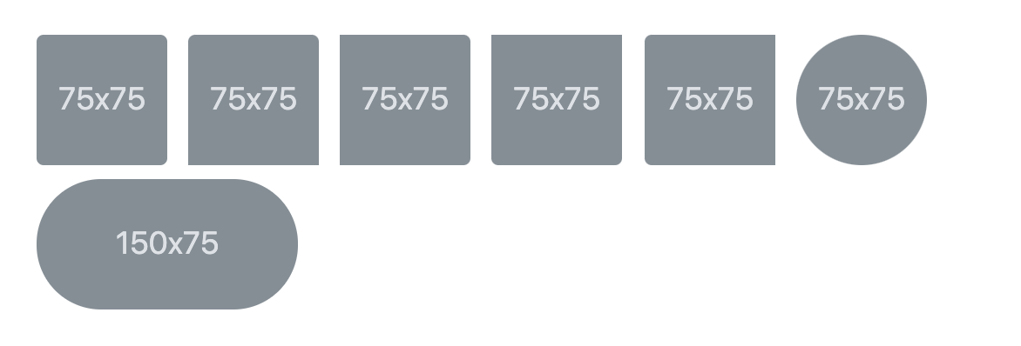
Border radius
Add classes to an element to easily round its corners.
<img src="..." class="rounded" alt="..."> <img src="..." class="rounded-top" alt="..."> <img src="..." class="rounded-end" alt="..."> <img src="..." class="rounded-bottom" alt="..."> <img src="..." class="rounded-start" alt="..."> <img src="..." class="rounded-circle" alt="..."> <img src="..." class="rounded-pill" alt="...">

Slide 8
Size of the border radius
<img src="..." class="rounded-0" alt="..."> <img src="..." class="rounded-1" alt="..."> <img src="..." class="rounded-2" alt="..."> <img src="..." class="rounded-3" alt="...">

